Slide 1
National
INJURY PREVENTION Week
November 13-17, 2023

Slide 2
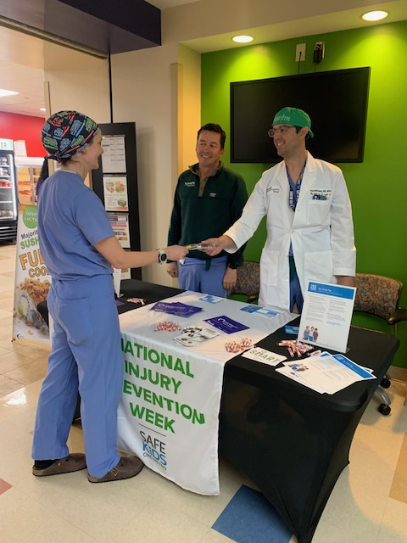
Firearm Safety

Slide 3
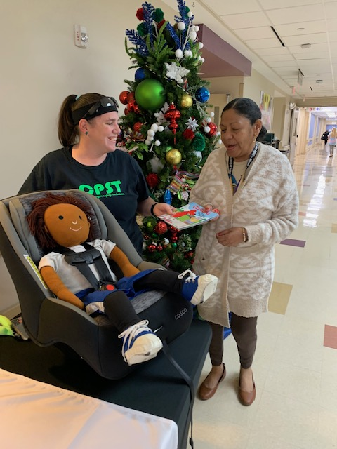
Child Passenger Safety

Slide 4
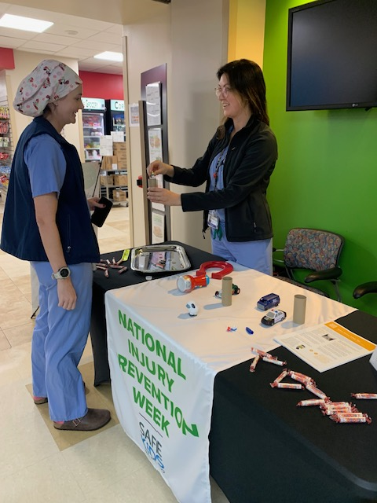
Magnets, Coins, and Batteries

Slide 5
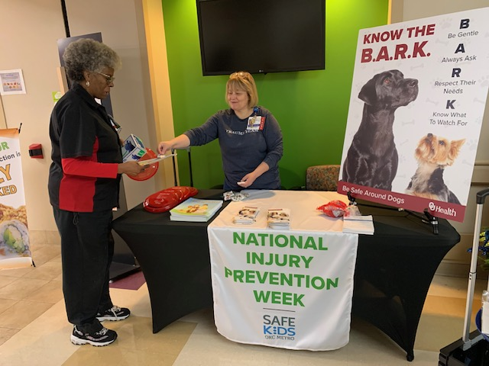
Dog Bite Prevention

Slide 6
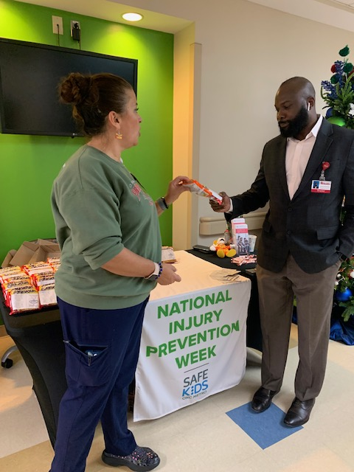
Burn Prevention

